Slide 1

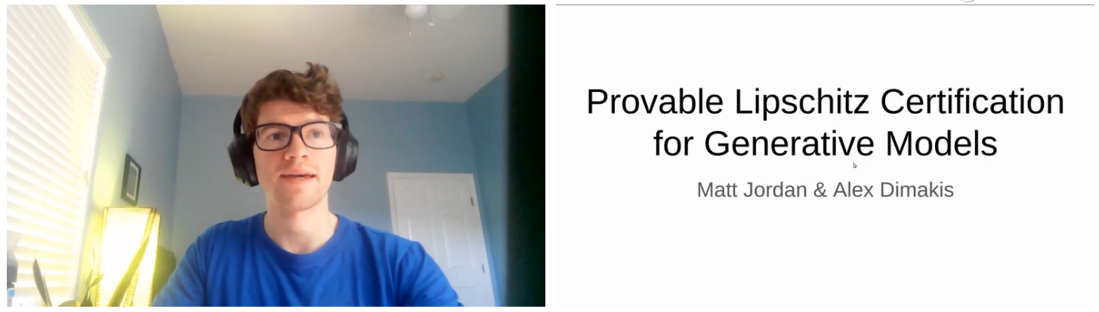
4th
Provable Lipschitz Certification for Generative Models
(Local Lipschitz Constant )
Matt Jordan, Alexandros G. Dimakis
University of Texas at Austin (美国)
ICML 2021
https://crossminds.ai/video/provable-lipschitz-certification-for-generative-models-614bd2803c7a224a909030cb/

Slide 2
Lipschitz Constant
Brief
Upper bound the Lipschitz constant of generative models
核心思想：把网络中所有向量用zonotope
将 Lipschitz constant of generative models与给定生成模型的可达到的 set of attainable vector-Jacobian products (VJPs) (向量雅可比乘积集，使用 zonotopes 的逐层凸近似来近似这个集合) 的最大范数联系起来。
之前大部分工作研究的是分类器，这项工作关注的是生成模型，例如VAE、DCGAN。
将算法扩展到了neural networks with large output dimension，即高维样本。
Challenge
The Lipschitz estimation technique for scalar-valued neural networks cannot be directly translated to vector-valued functions with high-dimensional output.
Solution
将 Lipschitz 常数估计问题构建为：对模型可达到的 vector Jacobian 乘积范围的优化。
通过逐层凸近似来过度近似这个集合，然后解决松弛版本的优化问题。
Matt Jordan, Alexandros G. Dimakis. Provable Lipschitz Certification for Generative Models. ICML. 2021.

Slide 3
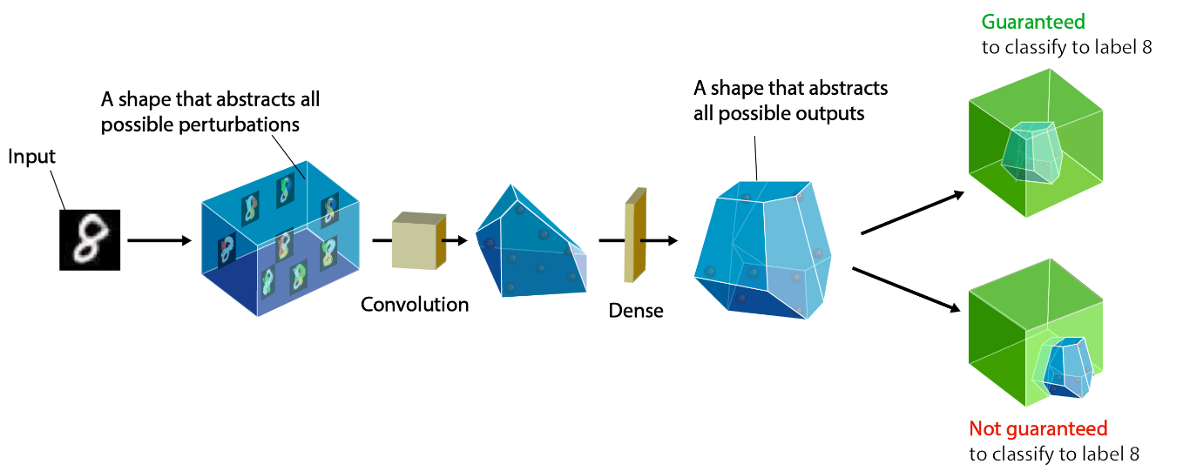
Lipschitz Constant
Background
如何通过逐层凸近似来过度近似模型可达到的 vector Jacobian 乘积集
过度近似：通过将其表示为 zonotope 来生成该集合的过度近似
前人工作做到了前向传播 zonotopes 对神经网络进行可达性分析
这项工作推广到了后向传播zonotopes 以代替向量
What is zonotope ?
Matt Jordan, Alexandros G. Dimakis. Provable Lipschitz Certification for Generative Models. ICML. 2021.

Slide 4
Lipschitz Constant
Background
如何通过逐层凸近似来过度近似模型可达到的 vector Jacobian 乘积集
过度近似：通过将其表示为 zonotope 来生成该集合的过度近似
前人工作做到了前向传播 zonotopes 对神经网络进行可达性分析
这项工作推广到了后向传播zonotopes 以代替向量
What is zonotope ?
zonotope：齐诺多面体，是一种集合表示
通过一系列非线性操作映射得到zonotope
求zonotope的最大范数等同于格洛腾迪克 (Grothendieck) 数学问题。
What is Reachability analysis ?
可达性分析：经常用抽象解释 (abstract interpretations) 的语言表达，其目标是设计合理的转换以映射集合如何经过给定分类器的前向传播。
常用集合类型：超盒 (hyperboxes) 、齐诺多面体 (zonotopes)、多面体 (polytopes)、imageStars、线性边界 (linear bounds)。
Matt Jordan, Alexandros G. Dimakis. Provable Lipschitz Certification for Generative Models. ICML. 2021.

Slide 5
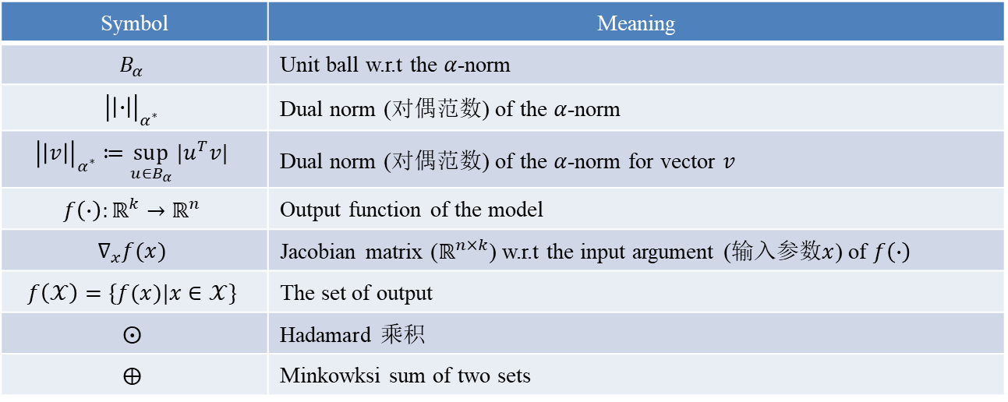
Lipschitz Constant
Problem Statement
问题：估计向量值函数(vector-valued functions )的 Lipschitz 常数
符号：
向量是小写
矩阵是大写
集合是花体
Symbol | Meaning
$$B_{α}$$ | Unit ball w.r.t the $α$-norm
$${\left|\left|∙\right|\right|}_{α^{∗}}$$ | Dual norm (对偶范数) of the $α$-norm
$${\left|\left|v\right|\right|}_{α^{∗}}≔\sup_{u∈B_{α}}{|u^{T}v|}$$ | Dual norm (对偶范数) of the $α$-norm for vector $v$
$$f\left(∙\right):ℝ^{k}→ℝ^{n}$$ | Output function of the model
$$∇_{x}f(x)$$ | Jacobian matrix ($ℝ^{n×k}$) w.r.t the input argument (输入参数$x$) of $f\left(∙\right)$
$$f\left(𝒳\right)=\{f(x)|x∈𝒳\}$$ | The set of output
$$⨀$$ | Hadamard 乘积
$$⨁$$ | Minkowksi sum of two sets
Matt Jordan, Alexandros G. Dimakis. Provable Lipschitz Certification for Generative Models. ICML. 2021.

Slide 6
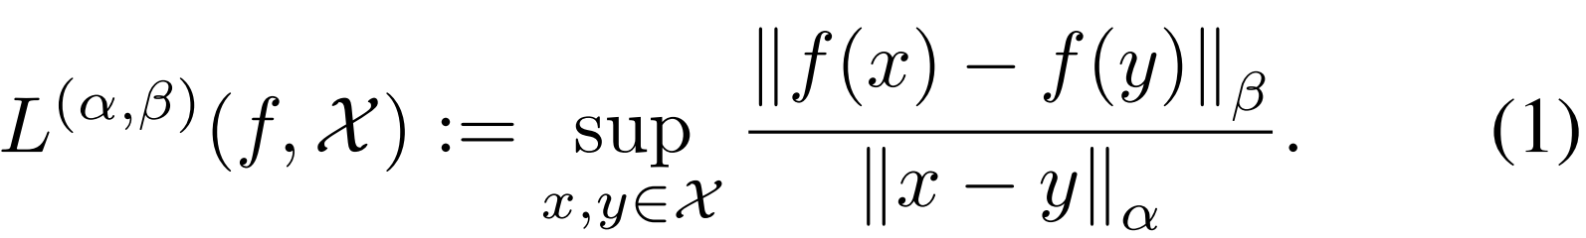
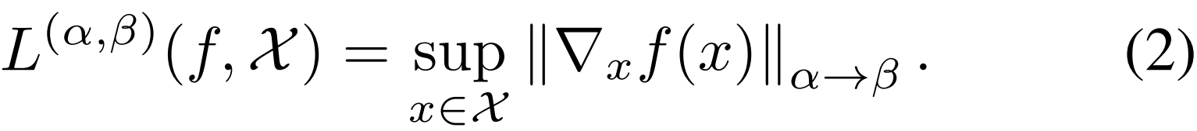

Lipschitz Constant
Problem Statement
Lipschitz constants of vector-valued functions
Neural network $f:ℝ^{k}→ℝ^{n}$
Input domain $𝒳⊆ℝ^{k}$
Norm over $ℝ^{k}$ $||∙|{\left.​\right|}_{α}$
Norm over $ℝ^{n}$ $||∙|{\left.​\right|}_{β}$
The local Lipschitz constant
当$f$ 连续可微且$𝒳$是一个开集时，局部Lipschitz常数可以写成对雅可比矩阵范数的优化，即
The matrix norm
对偶范数的定义
Matt Jordan, Alexandros G. Dimakis. Provable Lipschitz Certification for Generative Models. ICML. 2021.

Slide 7
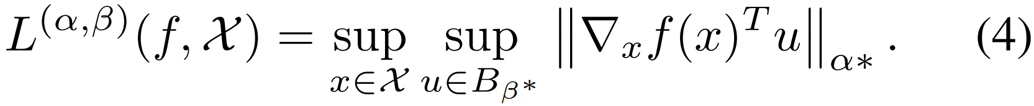

Lipschitz Constant
Problem Statement
Lipschitz constants of vector-valued functions
将计算 Lipschitz 常数的问题表述为对向量-雅可比积的优化
当 $f$不平滑时(例如ReLU)，(4)中对雅可比行列式 (Jacobian) 的优化被替换为对克拉克广义次梯度 (Clarke generalized subgradients) 的优化。
计算(4)中上限有两步：
第1步：生成 $f$的向量-雅可比乘积集的合理近似
开发一个满足如下包含关系的集合 $𝒴$
第2步：限定该集合的最大 ${\left|\left|∙\right|\right|}_{α^{∗}}$范数。
upper bound $𝒴$ 的最大 ${\left|\left|∙\right|\right|}_{α^{∗}}$范数
Matt Jordan, Alexandros G. Dimakis. Provable Lipschitz Certification for Generative Models. ICML. 2021.

Slide 8
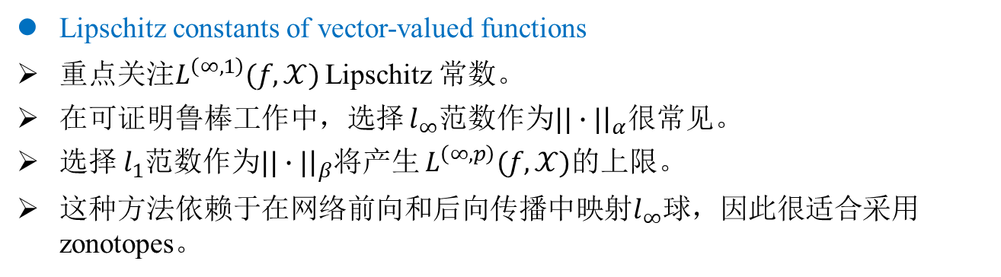
Lipschitz Constant
Problem Statement
Lipschitz constants of vector-valued functions
重点关注$L^{\left(∞,1\right)}(f,𝒳)$ Lipschitz 常数。
在可证明鲁棒工作中，选择 $l_{∞}$范数作为$||∙|{\left.​\right|}_{α}$很常见。
选择 $l_{1}$范数作为$||∙|{\left.​\right|}_{β}$将产生 $L^{\left(∞,p\right)}(f,𝒳)$的上限。
这种方法依赖于在网络前向和后向传播中映射$l_{∞}$球，因此很适合采用zonotopes。
Matt Jordan, Alexandros G. Dimakis. Provable Lipschitz Certification for Generative Models. ICML. 2021.

Slide 9
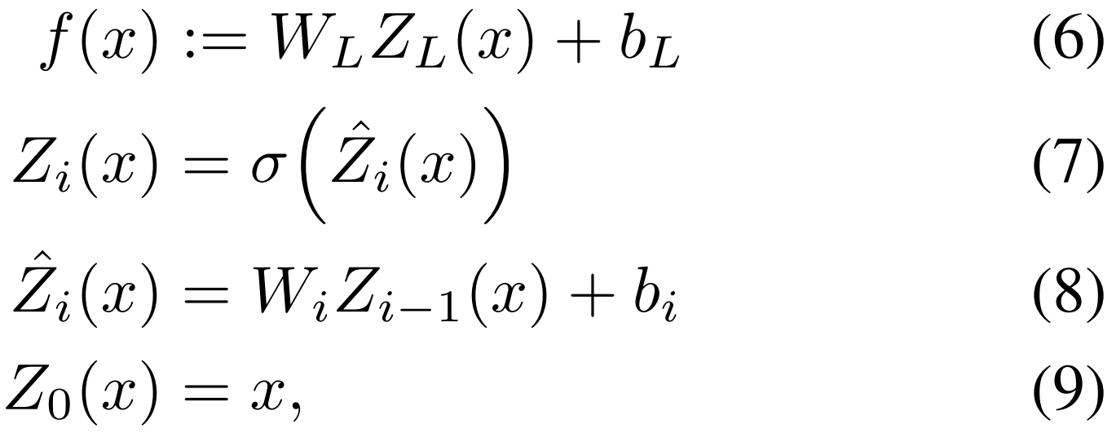
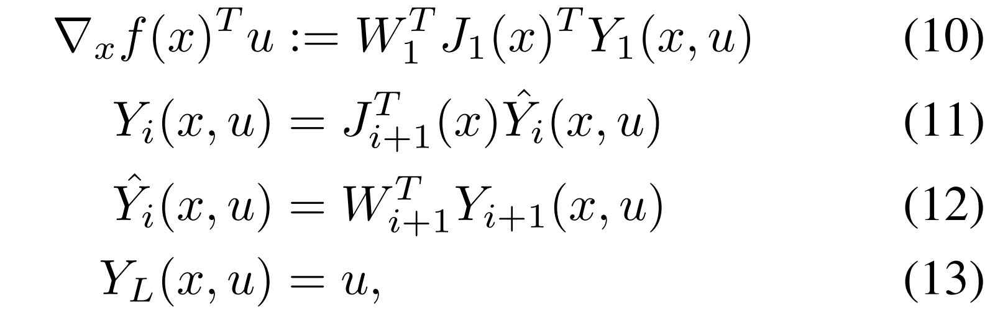

Lipschitz Constant
Problem Statement
Vector-Jacobian Products of Neural Networks
过度逼近向量雅可比积集
考虑具有全连接或卷积层、以及非线性元素$σ$ 的前馈神经网络。
评估具有 $L$个隐藏层的神经网络 $f$：
vector-Jacobian products 向量雅可比乘积
Matt Jordan, Alexandros G. Dimakis. Provable Lipschitz Certification for Generative Models. ICML. 2021.

Slide 10
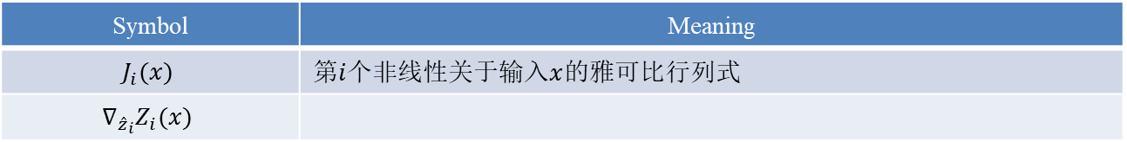
Lipschitz Constant
Problem Statement
Vector-Jacobian Products of Neural Networks
Symbol | Meaning
$$J_{i}(x)$$ | 第$i$个非线性关于输入$x$的雅可比行列式
$$∇_{{\hat{z}}_{i}}Z_{i}(x)$$
Matt Jordan, Alexandros G. Dimakis. Provable Lipschitz Certification for Generative Models. ICML. 2021.

Slide 11
Lipschitz Constant
Relaxation Strategy
提供了凸松弛策略的概述
Matt Jordan, Alexandros G. Dimakis. Provable Lipschitz Certification for Generative Models. ICML. 2021.

Slide 12
Lipschitz Constant
Hyperboxes
XXX
Matt Jordan, Alexandros G. Dimakis. Provable Lipschitz Certification for Generative Models. ICML. 2021.

Slide 13
Lipschitz Constant
Zonotopes
XXX
Matt Jordan, Alexandros G. Dimakis. Provable Lipschitz Certification for Generative Models. ICML. 2021.

Slide 14
Lipschitz Constant
Sound Pushforward Operators
XXX
Matt Jordan, Alexandros G. Dimakis. Provable Lipschitz Certification for Generative Models. ICML. 2021.

Slide 15
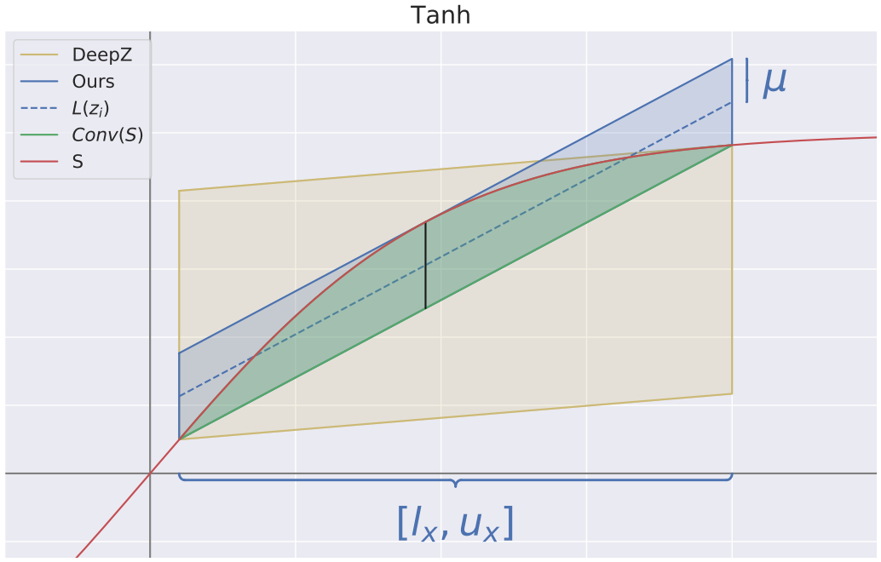
Lipschitz Constant
Vertical-Parallelogram fitting problem
Examples of the vertical parallelogram fitting algorithm for the tanh
Matt Jordan, Alexandros G. Dimakis. Provable Lipschitz Certification for Generative Models. ICML. 2021.

Slide 16
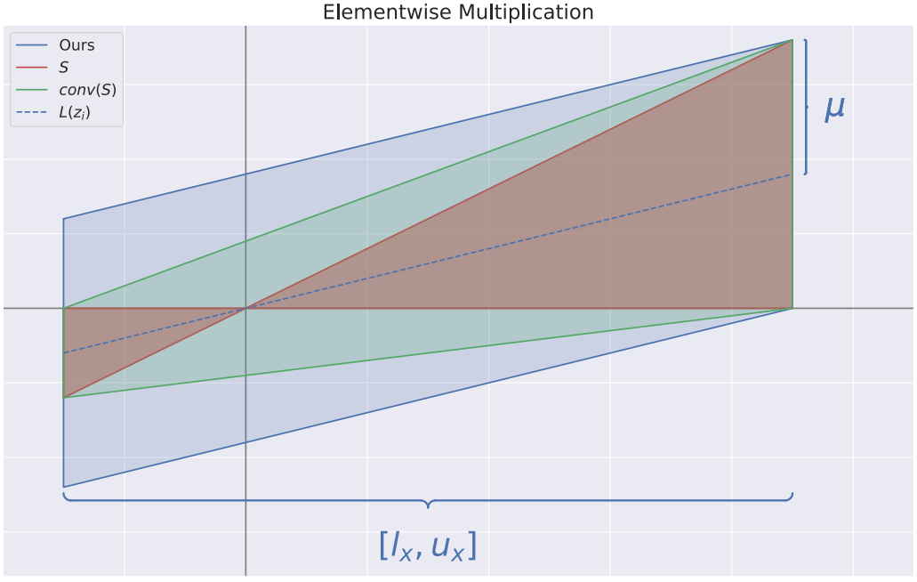
Lipschitz Constant
Vertical-Parallelogram fitting problem
Examples of the elementwise multiplication operators
Matt Jordan, Alexandros G. Dimakis. Provable Lipschitz Certification for Generative Models. ICML. 2021.

Slide 17
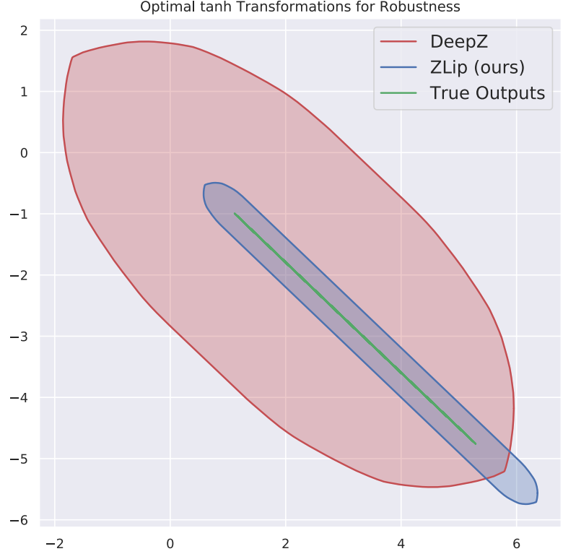
Lipschitz Constant
Vertical-Parallelogram fitting problem
For classifiers trained on the toy dataset, our improved tanh bounds yield tighter reachability analysis compared to prior work.
Matt Jordan, Alexandros G. Dimakis. Provable Lipschitz Certification for Generative Models. ICML. 2021.

Slide 18
Lipschitz Constant
Maximizing Norms over Zonotopes
XXX
Matt Jordan, Alexandros G. Dimakis. Provable Lipschitz Certification for Generative Models. ICML. 2021.

Slide 19
Lipschitz Constant
Maximizing Norms over Zonotopes
XXX
Matt Jordan, Alexandros G. Dimakis. Provable Lipschitz Certification for Generative Models. ICML. 2021.

Slide 20
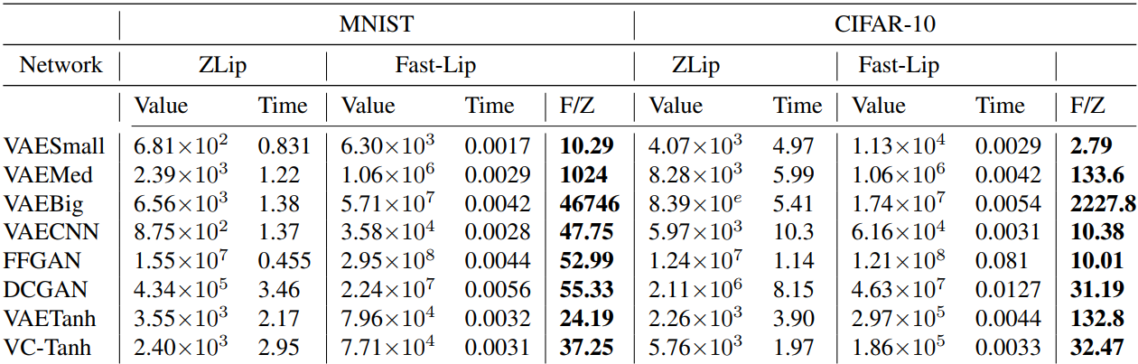
Lipschitz Constant
Experiment 1
Evaluation of ZLip and Fast-Lip on generative models trained on the MNIST and CIFAR-10 datasets, evaluated over inputs of radius 0.05.
Times are reported in seconds The column F/Z denotes the ratio of the estimate returned by Fast-Lip to our estimate.
For larger networks, ZLip can yield upper bounds that are several orders of magnitude tighter than Fast-Lip
Table 1
Matt Jordan, Alexandros G. Dimakis. Provable Lipschitz Certification for Generative Models. ICML. 2021.

Slide 21
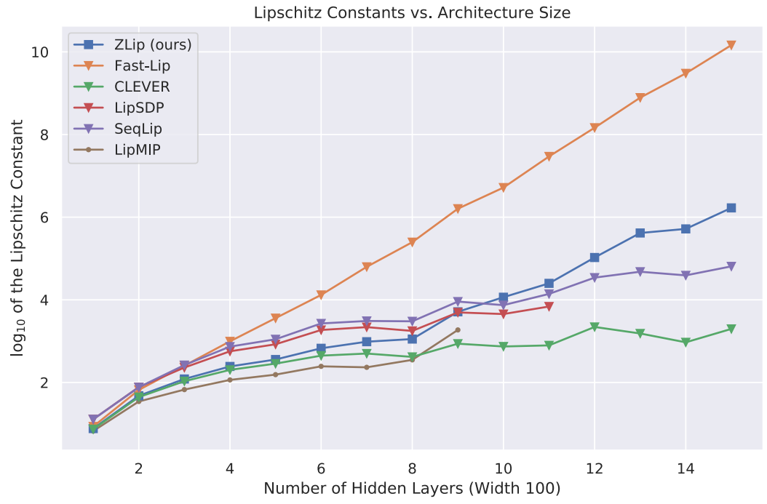
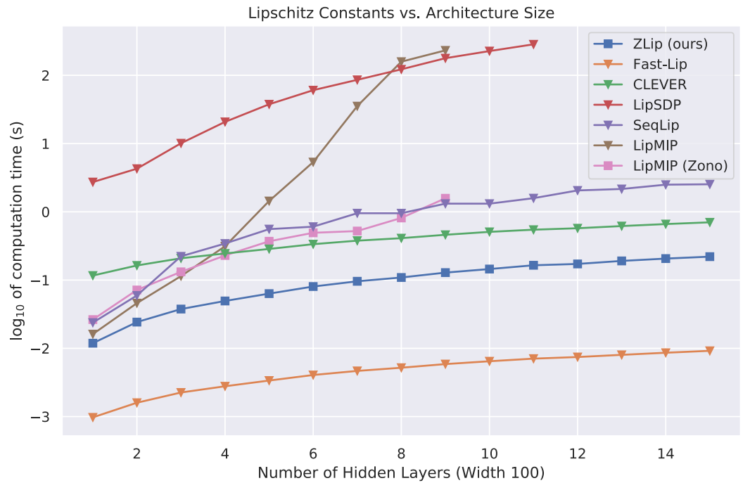
Lipschitz Constant
Experiment 2
Comparisons of Lipschitz estimate (left) and running time (right) for various Lipschitz estimation techniques on networks trained on the Circle dataset.
The horizontal axis is the number of hidden layers of the networks considered and the vertical axis is in log-scale.
Our approach is scalable to larger networks while still providing reasonably tight bounds.
Also note that using our approach within LipMIP dramatically improves the efficiency
Figure 2
Matt Jordan, Alexandros G. Dimakis. Provable Lipschitz Certification for Generative Models. ICML. 2021.

Slide 22
Lipschitz Constant
Conclusion
We have presented a principled way to efficiently upper bound the Lipschitz constant of neural networks with large output dimension.
我们提出了一种原则性的方法来有效地限制具有大输出维度的神经网络的 Lipschitz 常数。
Our technique improves upon prior works for zonotope approximations of neural networks and is applicable to the operators required by the backpropagation algorithm.
我们的技术改进了先前对神经网络的 zonotope 近似的工作，并且适用于反向传播算法所需的算子。
This approach yields tighter provable Lipschitz bounds for classifiers and is able to scale effectively to familiar generative models for the MNIST and CIFAR10 datasets, yielding improvements of up to three orders of magnitude for Lipschitz estimation of these networks.
这种方法为分类器产生了更严格的可证明 Lipschitz 界限，并且能够有效地扩展到熟悉的 MNIST 和 CIFAR10 数据集的生成模型，从而为这些网络的 Lipschitz 估计带来高达三个数量级的改进。
Matt Jordan, Alexandros G. Dimakis. Provable Lipschitz Certification for Generative Models. ICML. 2021.

